Slide 1
Anvaya Essence – Customer Segmentation & Purchase Behavior Analysis
- A Case Study by Anik Chakraborty

Slide 2
🎯 Objective
Project Purpose:
Analyze customer demographics, spending behavior, and purchase channels to uncover actionable insights. Identify high-value customer segments based on income, generation, education, and family structure. Evaluate purchase patterns across store and web channels to understand customer buying preferences.
Key KPIs:
Total Customers
Total Revenue (Total Spend)
Purchase Volume
Average Customer Income
Average Customer Age
Store Sales % vs Web Sales %
Average Recency (Customer Activity Level)
Deliverables:
Interactive Power BI Dashboard Pages
Customer Segmentation Analysis
Purchase Behavior & Channel Performance Insights
Business-ready data visualization for decision-making

Slide 3
📘 Project Overview
Context Highlights:
In today’s competitive retail environment, understanding customer behavior is essential for improving customer retention and maximizing revenue.
Businesses require deeper insights into who their customers are, how they purchase, and what factors influence their spending patterns. By analyzing customer demographic and purchase data, organizations can better identify high-value segments and optimize marketing strategies.
This project examines customer demographics, spending behavior, and purchase channels to uncover patterns that influence buying decisions and engagement levels.
The insights generated from this analysis help businesses to:
Identify high-value customer segments
Understand purchase channel preferences (Store vs Web)
Evaluate customer engagement and recency behavior
Support targeted marketing and revenue optimization strategies

Slide 4
🗂️ Data Overview & Schema
Data Source:
Source: Customer Marketing Dataset
Data Type: Structured transactional and demographic data
Time Period: Multi-year customer purchase history
Data Structure & Metrics:
Key Index Types: Customer ID (Primary Identifier), Demographic Attributes, Purchase Behavior Metrics
Total Rows: ~2,200 customer records
Categories:
Demographics: Age Group, Generation, Education, Marital Status
Financial: Income, Income Segment
Household: Total Children
Purchasing Behavior: Store Purchases, Web Purchases, Total Purchases
Spending Metrics: Product Category Spending, Total Spend (Total Revenue)
Calculated Metrics:
Total Revenue (Total Spend),
Purchase Volume,
Average Customer Spend,
Store Sales % & Web Sales %,
Generation Segmentation,
Income Segmentation,
Age Group Segmentation,
Customer Recency Status (Active / Slipping / At Risk)

Slide 5
💻 Tech Stack
Tools:
Excel
Data cleaning & preprocessing
PowerQuery
Data Transformation & Shaping
Column Standardization
Data Preparation for BI Integration
PowerBI
Dashboard & Visualization
Data Modeling & Relationship Building
DAX – KPI Calculations Columns & Measures
Slicers & Dynamic Filtering
PowerPoint
Presentation and final dashboard snapshots

Slide 6
📈 Methodology & Analysis
Preparation, Process & Analytical Approach:
Data Preparation & Cleaning:
Removed inconsistent or missing values
Standardized categorical, numeric, and date fields
Created derived attributes: Age, Age Groups, Generation
Data Modeling & Integration:
Structured dataset using Customer ID as primary index
Created calculated columns and KPI measures using DAX
Optimized model for efficient dashboard performance
Feature Engineering:
Developed segmentation variables:
Generation Segmentation (Gen Z, Millennials, Gen X, Boomers)
Income Segmentation (Low, Medium, High)
Age Groups & Customer Recency Status
Channel Sales % and Total Purchase Volume
Visualization Design:
Built two interactive Power BI dashboards
Used KPI cards, bar charts, stacked bars, and combo charts
Applied consistent visual theme and segmentation-based layout
Validation & Formatting:
Verified KPI calculations and aggregations
Ensured consistent formatting and dashboard clarity

Slide 7
❓ Problem Statement
To better understand customer behavior and revenue drivers, the analysis focuses on identifying patterns across demographic segments, spending habits, and purchase channels. The following key questions guide the exploration of the dataset and help uncover actionable business insights.
Key Questions:
Which customer segments generate the highest revenue?
How does spending vary across different age groups and generations?
Which income segments contribute the most to overall revenue?
How does education level influence purchasing behavior?
What are the preferred purchase channels (Web vs Store) among customers?
Which customers are active, slipping, or at risk of churn based on recency?
How do purchase frequency and total revenue correlate across customer segments?

Slide 8
💡 Key Insights
Top Findings:
Middle-aged customers (Age 49–58) and the Gen X generation contribute the highest share of total revenue and purchase volume, making them the most valuable customer segment.
High-income customers generate significantly higher spending, indicating a strong link between income level and purchasing power.
Customers with no children at home tend to spend more on average, suggesting higher disposable income.
Graduates and postgraduate customers represent a large portion of the customer base and spending activity.
Store purchases dominate overall transactions, showing a strong preference for offline shopping, while web purchases represent a smaller but steadily growing channel.
Customer recency analysis shows most customers fall into Active or Slipping segments, highlighting opportunities for targeted retention strategies.
Supporting Metrics:
Total Customers: ~2,200
Highest Spending Age Group: 49–58
Dominant Generation: Gen X / Older Millennials
Store Sales Share: ~60% of total purchases
Web Sales Share: ~40% of total purchases
Primary Revenue Segment: Medium-to-High income customers
Average Customer Spend: Indicates moderate to high purchasing capacity

Slide 9
📍Conclusion
Summary:
Customer purchasing behavior is strongly influenced by demographic factors such as age, income, education, and household structure.
Middle-aged and higher-income customers contribute the most to overall revenue, making them key high-value segments.
Store purchases dominate over web purchases, indicating strong offline engagement while highlighting potential growth opportunities for online channels.
Customer recency analysis reveals opportunities to retain slipping customers and re-engage inactive segments.
These insights enable businesses to design targeted marketing strategies, improve customer retention, and optimize revenue performance.

Slide 10
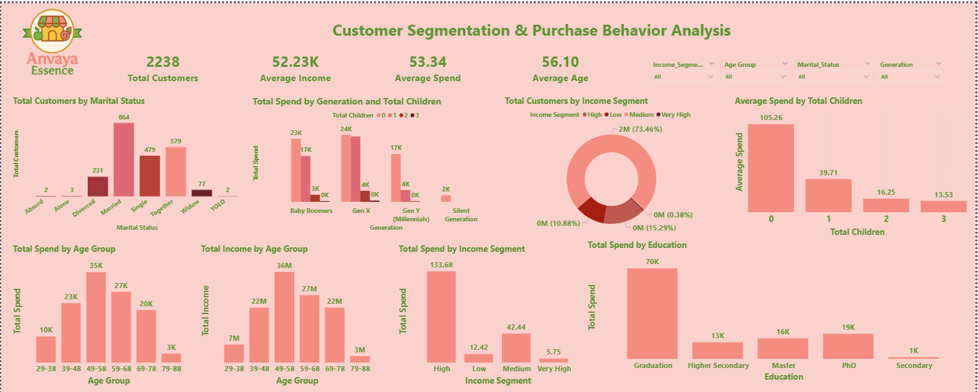
🖥️ Dashboard Overview (1) – Customer Segmentation

Slide 11
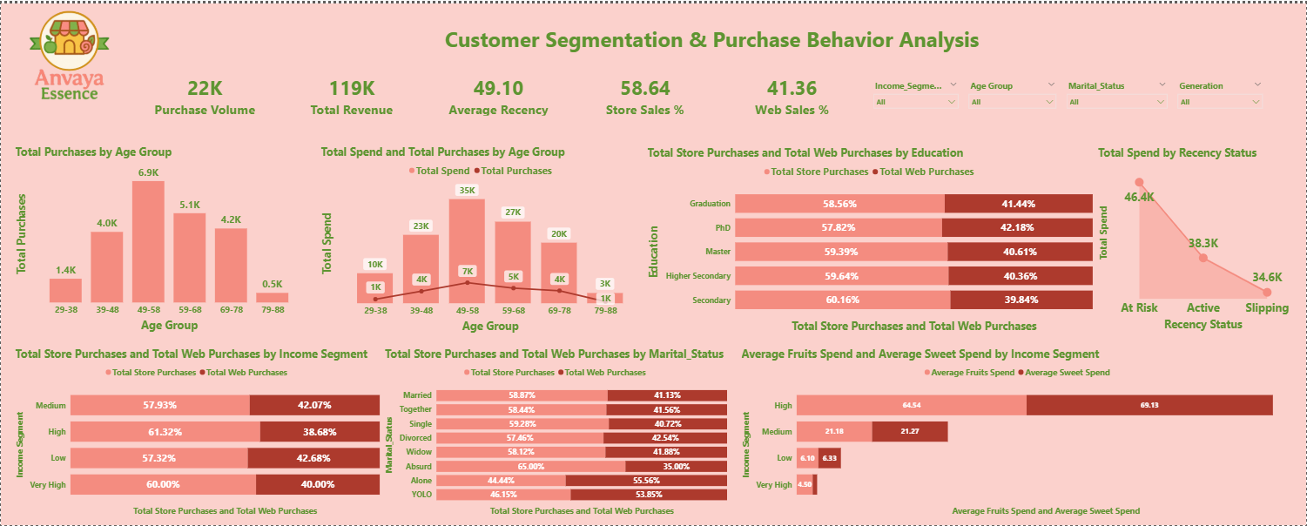
🖥️ Dashboard Overview (2) – Purchase Behavior

Slide 12
✅ Business Impact & Use Cases
The insights generated from this dashboard support data-driven marketing, sales, and customer strategy decisions.
Marketing Strategy:
Identify high-value customer segments based on income, age group, and spending behavior to design targeted and personalized marketing campaigns.
Customer Retention:
Use recency analysis to detect slipping or at-risk customers and implement re-engagement strategies to reduce churn.
Sales Channel Optimization
Analyze store vs web purchase patterns to understand customer channel preferences and improve online sales adoption.
Strategic Decision Making:
Provide actionable insights for leadership teams to optimize customer engagement, revenue growth, and marketing investments.
Business Value:
This dashboard enables organizations to:
Identify high-spending customer segments
Improve targeted marketing strategies
Strengthen customer retention initiatives
Evaluate offline vs online sales performance
Support data-driven business decision making

Slide 13
🙏 Acknowledgement & Contact
Project Analyst: Anik Chakraborty 📧 Email: anikc1710@gmail.com
Special Thanks To:
Coding Ninjas – for project framework and guidance
Connect: 🔗 GitHub | 🔗 LinkedIn

Slide 14
Thank You!

